Slide 1
CEIS150
By Charles Purnell

Slide 2
Introduction
CEIS150 has been a journey going through the motions of how to create your own stock tracking program on python this will help me get seen for companies who are looking for a programmer analyst.

Slide 3
Software environment setup
We learned how to setup the environment used to develop the stock tracking application.
I learned different software programs you can use to develop the stock tracking application.

Slide 4
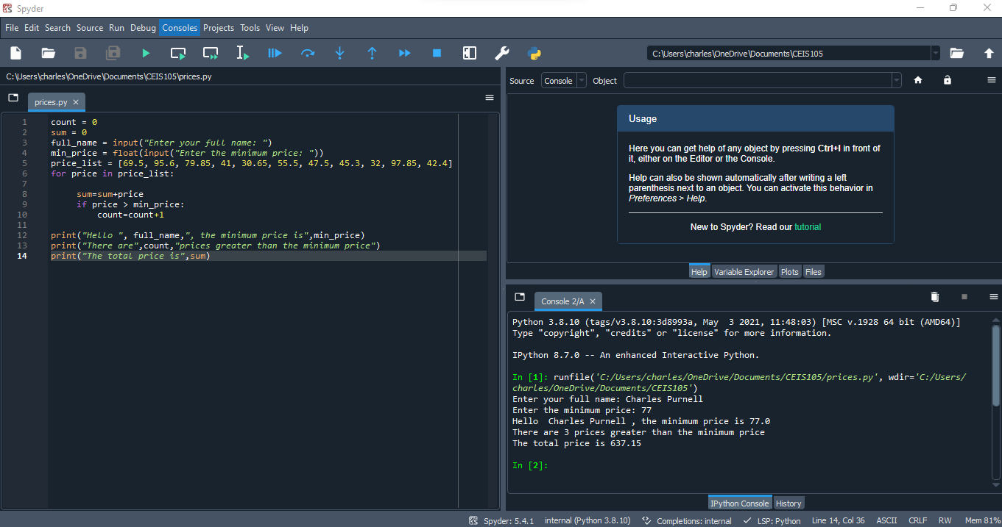
Program

Slide 5
Class Diagrams, Class Coding, Unit Testing
This part is building the foundation of the program by creating classes to work with the stock and history data.
Learned how to make symbol, name, and shares for the stock and double checking to make sure everything works in the beginning.

Slide 6
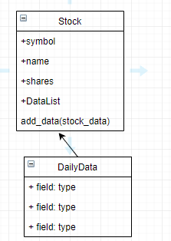
Class Diagram

Slide 7
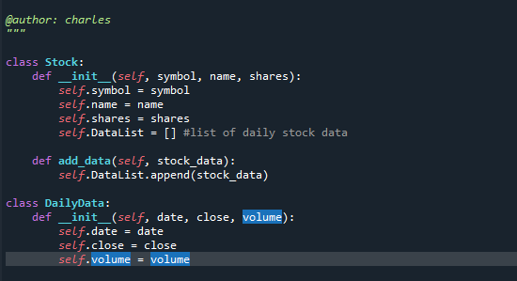
Class Code

Slide 8
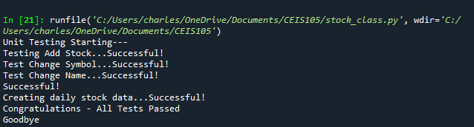
Unit Test

Slide 9
Text-Based User Interface Summary Report
Creating a console-based interface for working with stock and stock price history.
Learned how to add stocks to the stock list

Slide 10
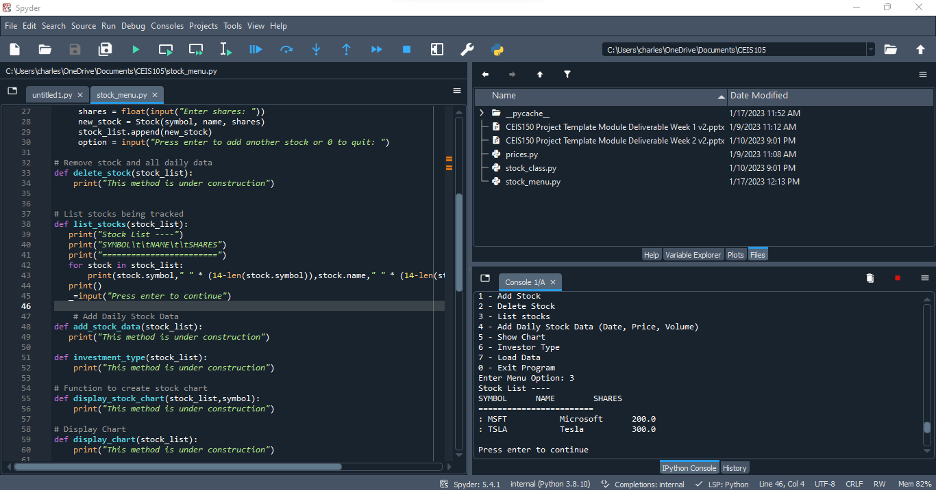
Adding a Stock

Slide 11
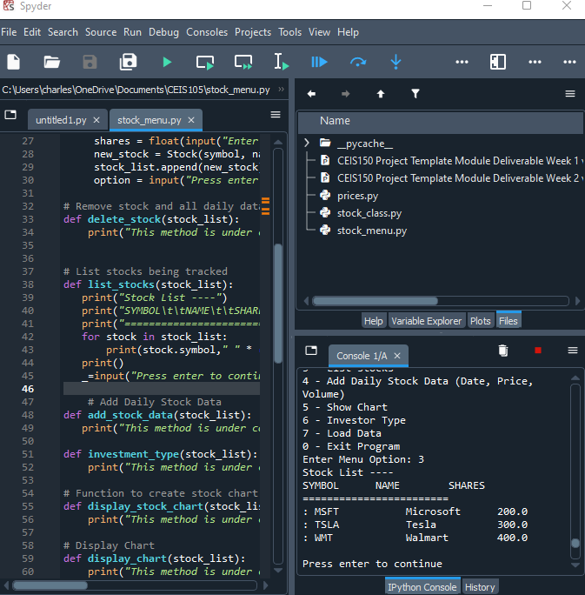
Listing 3 Stocks

Slide 12
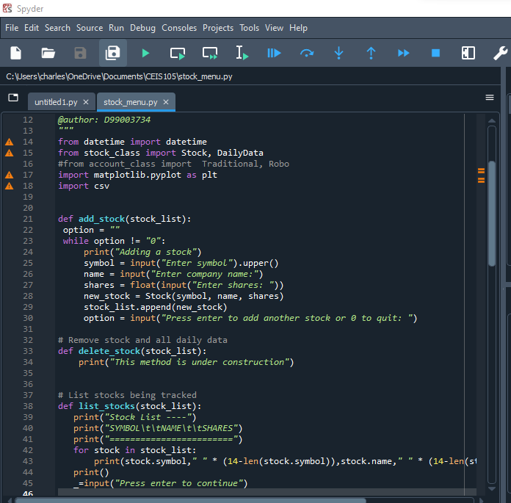
Daily Data

Slide 13
Inheritance Summary Report
Implementing inheritance into the stock program.
Learned how to write code for inherited classes.

Slide 14
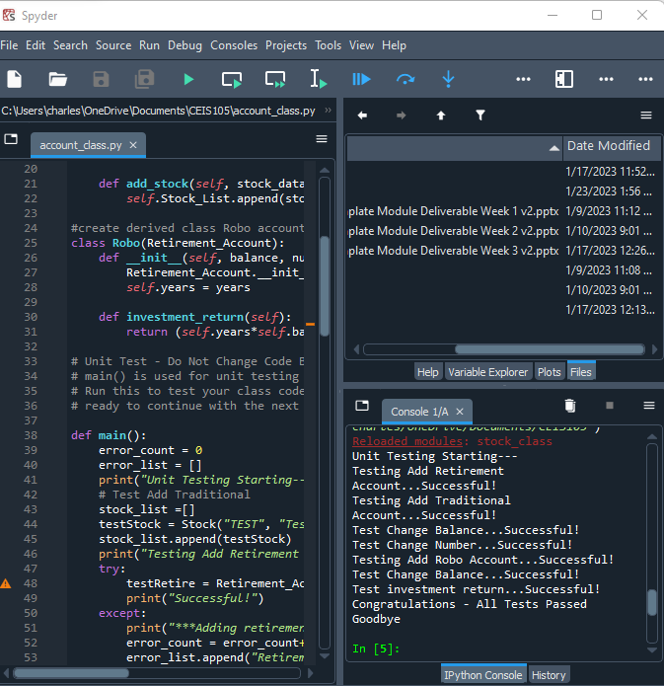
Inherited classes

Slide 15
Unit Tests

Slide 16
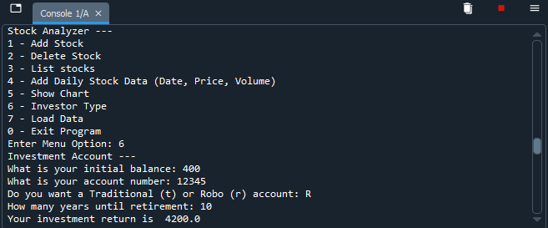
Stock menu program

Slide 17
Creating a Chart
Created a chart using stock prices overtime.
Learned how to use matplotlib

Slide 18
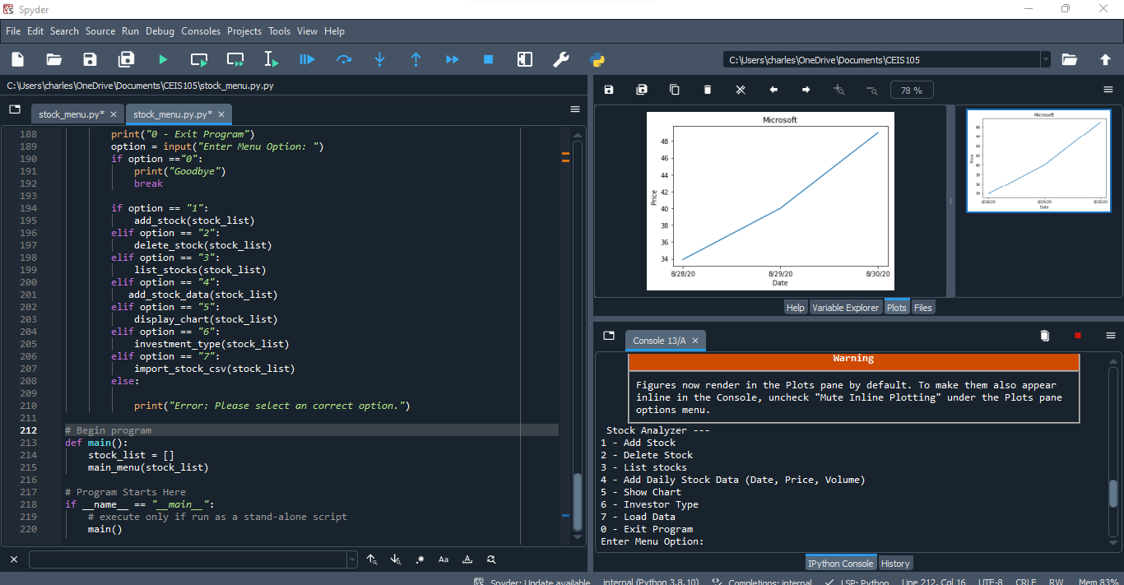
Chart

Slide 19
Loading data
Implement the ability to load data from csv file.
Upload data to stock application with csv file

Slide 20
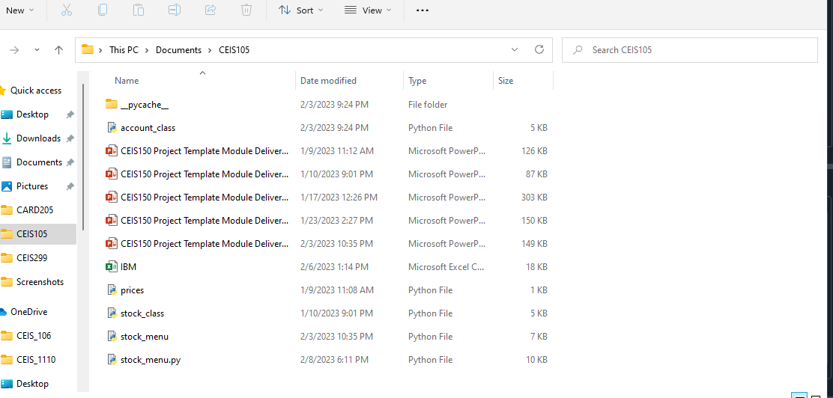
File

Slide 21
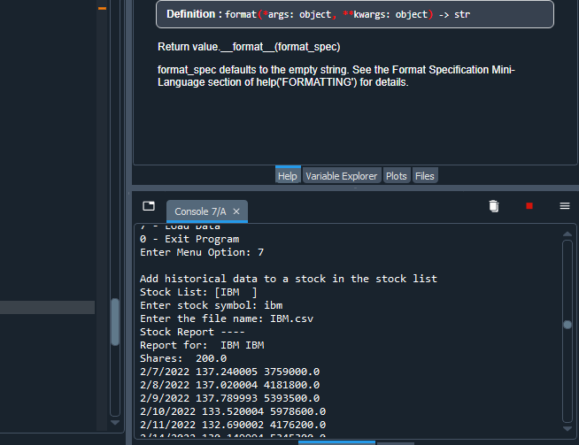
Importing data

Slide 22
GUI (Graphical User Interface)
implement a graphical user interface for your stock tracking program.
Learned an easier way to keep track of stock history and data.

Slide 23
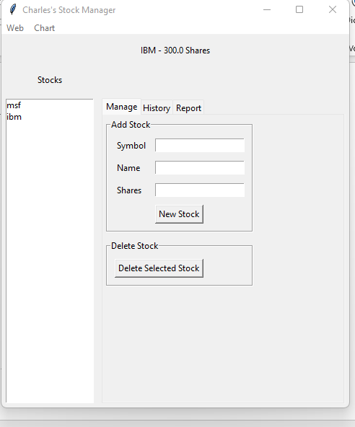
Stocks in GUI

Slide 24
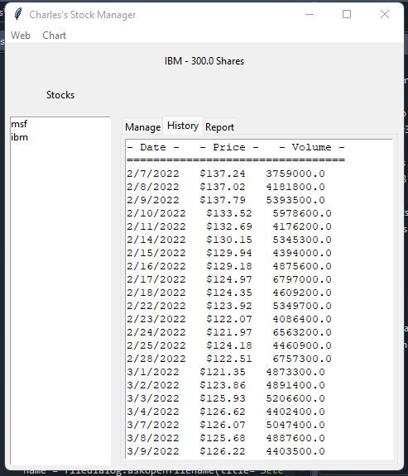
History Tab

Slide 25
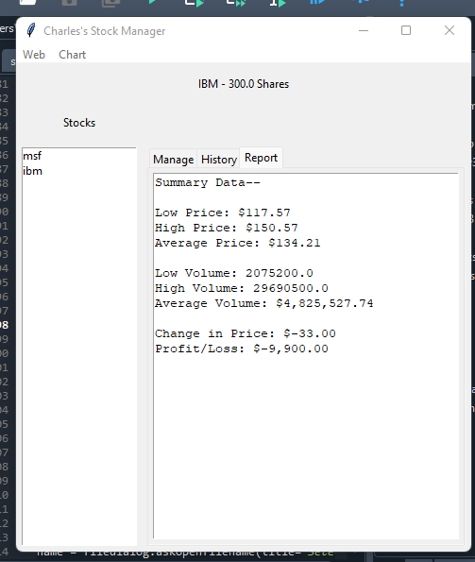
Report Complete

Slide 26
Career Skills Developed
The career skills I developed is working with python on Spyder
Learning how to add stocks, delete, stocks and make a stock list and implement it into a chart
I also learned easier coding techniques and different uses of python language

Slide 27
Conclusion
This will help me in the job field for companies that need someone to keep track of their stock and make a spreadsheet for them and it can be helpful for people in accounting and program analysts.

